Slide 1
PID – 199 Construction in Desert Area Developed By : Itisha Desai Branch – Cyber Security Batch – CS12 Enrollment No. – CS18

Slide 2
Problem Statement
Construction of low-cost load infrastructure suitable for creek and rann area.
Name of the Department : Border Security Force (BSF).
Users : BSF troops.

Slide 3
What are the problems ?
The first problem is The soil of the Creek and Rann area, due to salinity adversely affects the load constructed with routine bitumen mixture and it does not last too long.
The load requires frequent/regular maintenance to make it operational worthy.
Which is regularly affecting BSF operational activities on border and eating away much of BSF budget allocation.

Slide 4

What steps will become helpful in this problem ?
At first, we should create a web-site which shows Solution.
The web-site should provide correct information and solution about it.
In addition, it is also mandatory to provide information about BSF.

Slide 5

What is my help in this project ?
We have to develop a material that can be easily used for construction in the salty and sandy desert soils. Which is not affected by salts, which does not require as much maintenance as a regular bitumen mixture, which is strong enough to be used to withstand the pressure of vehicle movement and also could sustain the adverse impact of soil to last for a longer period and do not require much effort on maintainance, which is durable and affordable, which save man power, money and also geological soil, which does not affect BSF operational activities by maintaining the compound and which is affordable for BSF budget allocation.

Slide 6
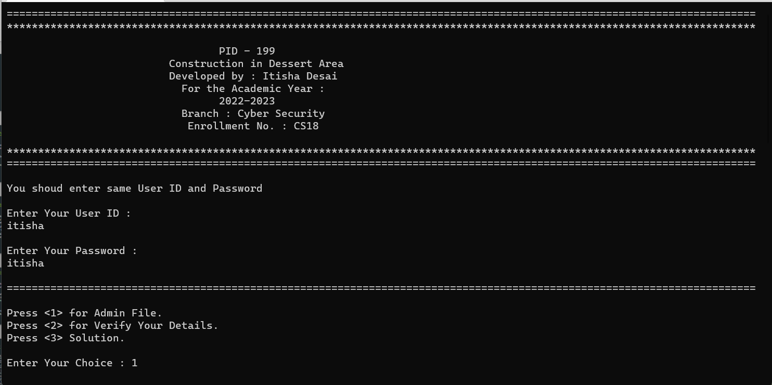
Output of Source Code :

Slide 7
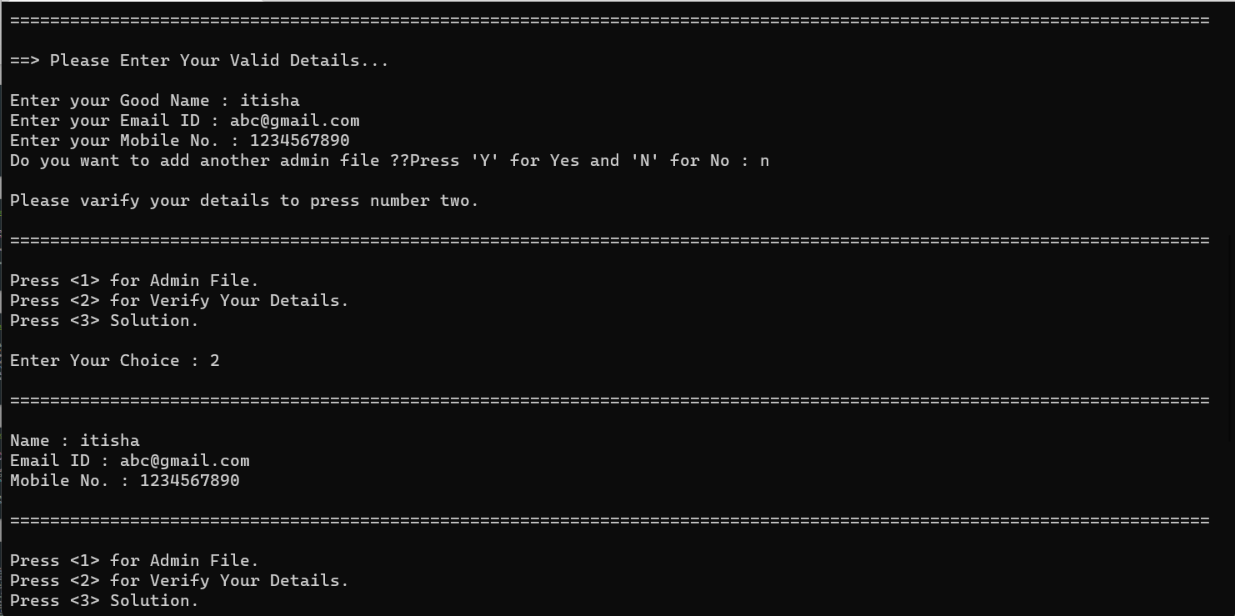

Slide 8
